Slide 1

FEB 2026
2023 Retail Sales Performance Dashboard.
TRANSFORMING RAW DATA INTO STRATEGIC BUSINESS INTELLIGENCE
BY AFRAH ALANAZI

Slide 2
The Challenge & Objective
PROBLEM
OBJECTIVES
Dealing with a massive dataset of over 25,000 transactions that lacked clear visibility into true profitability.
To build a centralized, interactive tool that monitors financial health, sales rep performance, and distribution efficiency in real-time.

Slide 3
  Data Engineering Methodology
DATA HYGIENE
ADVANCED METRICS:
AGGREGATION
Executed a rigorous cleaning process to eliminate duplicates and handle null values.
Developed the "Net Profit After Discount" formula to move beyond gross sales and reflect actual earnings.
Leveraged Pivot Tables to condense thousands of rows into high-level strategic summaries.

Slide 4
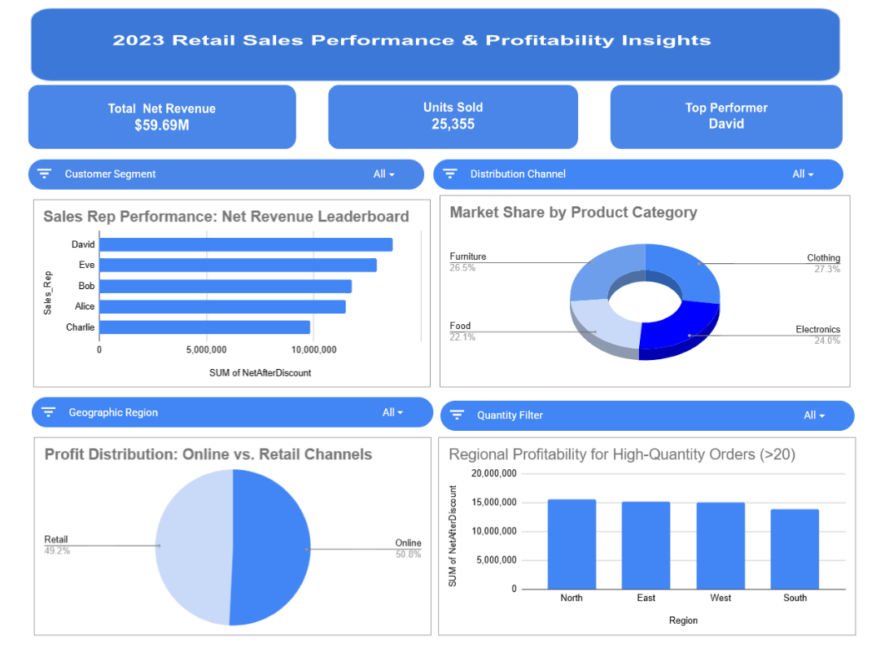
Dashboard Solution Overview
  VISUAL INTERFACE: A PROFESSIONAL, BLUE-THEMED INTERACTIVE DASHBOARD FEATURING SYNCHRONIZED CHARTS.
  EXECUTIVE SCORECARDS: IMMEDIATE VISIBILITY INTO $59.69M TOTAL NET Revenue and 25,355 Units Sold.
  Top Talent Tracking: Automated identification of the leading sales performer (David).

Slide 5
Key Business Insights
  Market Share: Clothing is the dominant category at 27.3%, followed closely by Electronics at 24%.
  Channel Strategy: Online channels slightly outperform Retail (50.8% vs. 49.2%), suggesting a shift toward digital-first investment.
  Regional Dominance: The North and East regions are the most profitable hubs for high-quantity bulk orders.

Slide 6
Interactivity & Stakeholder Empowerment
DYNAMIC FILTERING
USER EXPERIENCE
Integrated Slicers for Region, Channel, Segment, and Quantity to allow managers to "drill down" into specific data.
Designed for non-technical stakeholders to find answers to complex business questions in seconds.

Slide 7
Conclusion & Next Steps
Impact: This dashboard reduces reporting time and enables data-driven decision-making for the 2024 fiscal year.
Future Scope: Potential integration with SQL for automated data fetching and expansion into predictive analytics.

